Slide 1
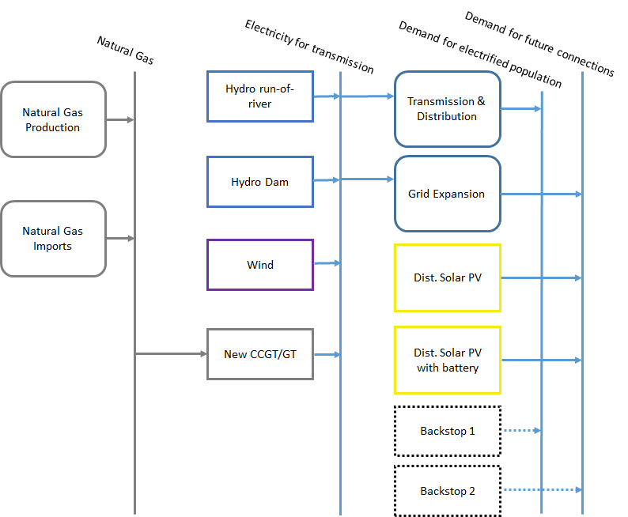
Thermal power plants in the RES
Resources
Primary
Secondary
Final

Slide 2
Thermal power plants in the RES
Resources
Primary
Secondary
Final

Slide 3
Defining a thermal power plant in OSeMOSYS
Examples
Coal
Coal-fired Power Plant
Electricity
Biomass/Waste
Biomass-fired Power Plant
Electricity
Natural gas
Natural gas-fired Power Plant
Electricity
Heavy fuel oil
Oil-fired Power Plant
Electricity
Diesel
Diesel-fired Power Plant / Engine
Electricity

Slide 4
Defining a thermal power plant in OSeMOSYS
In OSeMOSYS, thermal power plants are characterized by the following parameters:
InputActivityRatio: defines the rate of fuel consumed (i.e. Gas)
OutputActivityRatio: defines the rate of fuel provided (i.e. Electricity)
CapitalCost [M$/GW or $/kW]: defines the overnight investment cost of the plant
FixedCost [M$/GW or $/kW]: defines the fixed Operation & Maintenance cost
VariableCost [M$/GWh]: defines the variable costs of the plant
ResidualCapacity [GW]: defines the existing total capacity available in each year for a specific type of power plant
AvailabilityFactor: capacity available on average over one year expressed as a fraction of the total installed capacity, with value ranging from 0 to 1. It gives the possibility to account for planned outages.

Slide 5
Defining a thermal power plant in OSeMOSYS
In OSeMOSYS, thermal power plants are characterized by the following parameters:
OperationalLife [yr]: defines the lifetime of the technology.
Optional:
CapacityFactor: capacity available on average over every time slice expressed as a fraction of the total installed capacity, with value ranging from 0 to 1. It gives the possibility to account for unplanned outages.
TotalAnnualMaxCapacity, TotalAnnualMinCapacity [GW]: total maximum/minimum existing (residual plus cumulatively installed) capacity allowed for a technology in a specified year.
TotalAnnualMaxCapacityInvestment TotalAnnualMinCapacityInvestment [GW]: maximum/minimum planned new capacity allowed to be installed for a technology in a specified year.

Slide 6
Defining a thermal power plant in OSeMOSYS
Coal
Coal-fired Power Plant
Electricity
OutputActivityRatio: always at least one output - electricity
InputActivityRatio: always at least one input: fossil fuel, biomass, waste, etc.
e.g. InputActivityRatio – Coal – 3
OutputActivityRatio – Electricity – 1
Meaning that for 1 energy unit of electricity, 3 energy units of coal are needed

Slide 7
Defining a thermal power plant in OSeMOSYS
CapitalCost, VariableCost, FixedCost:
Fuel
Other consumables (e.g. chemicals, detergents, etc.)
Salaries
Taxes and insurance
Fixed fuel costs
Depreciation
Return on investment
Other one-time fixed charges

Slide 8
Defining a thermal power plant in OSeMOSYS
AvailabilityFactor: Maximum time a technology can operate in the whole year, as a fraction of the year ranging from 0 to 1. It accounts for planned outages.
CapacityFactor: Capacity available in each time slice expressed as a fraction of the total installed capacity, ranging from 0 to 1. It accounts for unplanned outages.
OperationalLife: Useful lifetime of a technology, expressed in years.

